Slide 1

Open-Eye EEG for Biometric Security
A Deep Learning Approach
Fayth Norzin
Aaron Alymann Jeyaraj
Mentor: Dr. Rig Das
UWL Computer Science Department
Notes:
Good afternoon everyone.
My name is Aaron Alymann Jeyaraj, and I’m excited to present my research on Open-Eye EEG for Biometric Security: A Deep Learning Approach.
This work was carried out under the guidance of Dr. Rig Das as part of the Dean’s Distinguished Fellowship, and is housed within the Computer Science Department here at UW–La Crosse.
In the next few minutes, I’ll walk you through what this research is about, why it matters, the methods I used, and what we found.

Slide 2

Abstract
What is EEG Biometric Authentication?
Utilizes unique brain activity patterns for identification.
Nearly impossible to forge compared to fingerprints or facial recognition.
Key Methods:
Data collected using an EEG headset under Open-Eye protocols
Focus Areas:
EEG preprocessing pipeline: filtering, normalisation, downsampling, and segmentation
CNN architecture optimised for spatial and temporal features
Use of majority voting to improve subject-level predictions.
Non-visible and user-specific
Processed EEG segments analysed using a Convolutional Neural Network (CNN).
Each trial segmented into 5-second windows for subject identification
Notes:
“To begin with, let me introduce what EEG biometric authentication is.
This approach uses unique brain activity patterns to identify individuals. Unlike fingerprints or facial recognition, EEG signals are non-visible and much harder to forge. They’re inherently user-specific because brainwave patterns vary from person to person—even under similar conditions.
In this project, I collected EEG data using a EEG headset while participants kept their eyes open, a condition known as the open-eye protocol.
The EEG signals were preprocessed—filtered, normalised, downsampled, and segmented into 5-second windows. These segments were then passed into a Convolutional Neural Network, or CNN, for subject identification.
My focus was on designing a CNN that could extract meaningful spatial and temporal features from the EEG data. I also implemented majority voting across multiple segments to improve subject-level prediction reliability.”

Slide 3
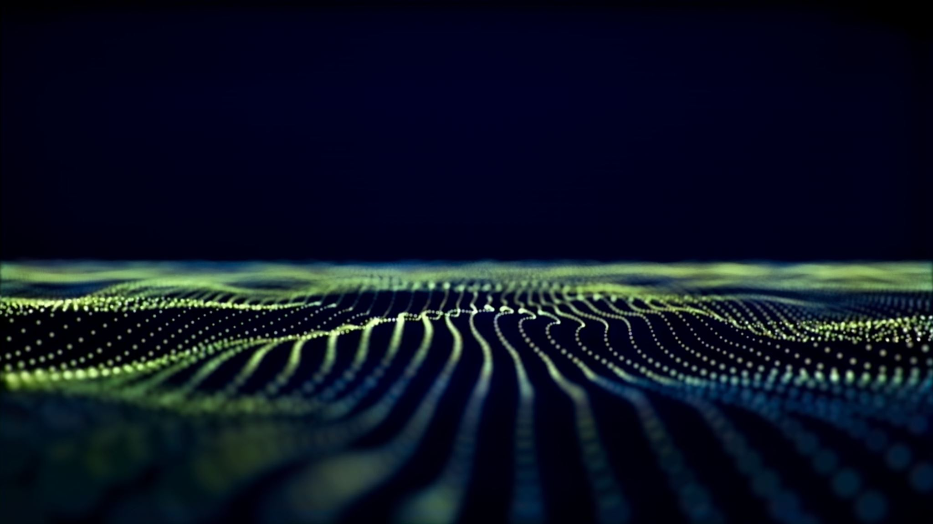
Why EEG for Biometric Security?
The Problem with Conventional Biometrics:
Fingerprints and facial recognition can be copied or spoofed.
Physical traits are visible, permanent, and exposed to risk.
Why EEG Signals?:
Captures invisible brainwave patterns (unique to each person).
Constantly changing and internal, making it harder to fake or steal.
Why Focus on Open-Eye EEG?
More practical than eyes-closed or stimulus-based tasks.
Reflects real-world, alert-state brain activity — closer to real usage.
Breaches can be irreversible ( you can’t change your fingerprint, “technically”).
Even short brain activity windows can reflect deep personal traits.
Notes:
One of the key problems with conventional biometrics like fingerprints or facial recognition is that they can be copied, spoofed, or leaked. Since these traits are visible and permanent, any breach can be very serious — you can't exactly ‘change’ your fingerprint.
EEG offers a very different kind of biometric. It’s internal, invisible, and unique to every person. The brain’s electrical activity is constantly changing depending on mood, focus, or mental state, which makes it much harder to replicate or steal. Even brief EEG recordings can carry enough unique features to distinguish individuals.
So why focus on open-eye EEG specifically?
Most EEG research uses eyes-closed or stimulus-driven tasks, which aren’t realistic in practical use. Open-eye EEG captures real-world, alert-state brain activity — the kind of data you'd expect in a real application. It's more practical, more natural, and closer to actual everyday usage scenarios.”

Slide 4
Research Question & Hypothesis
Research Question:
Can a deep learning model, specifically a Convolutional Neural Network (CNN), accurately identify individuals based on short segments of EEG data collected under open-eye protocols?
Hypothesis:
A CNN trained on 5-second open-eye EEG segments will learn spatial and temporal brainwave patterns unique to individuals, enabling reliable subject-level biometric authentication.
Notes:
The core question driving my research is this: Can a deep learning model — specifically a Convolutional Neural Network — accurately identify individuals based on short EEG segments collected while their eyes are open?
This is an important question because most prior work has focused on eyes-closed or stimulus-driven EEG, which are harder to use in real-world applications.
My hypothesis is that a CNN trained on just 5-second open-eye EEG windows can learn both spatial and temporal brainwave features that are unique to each person. If this is true, it would allow us to authenticate users based on these natural EEG signatures — reliably and securely, even under real-world conditions.”

Slide 5
Literature Survey
What Studies Show:
Importance of preprocessing (e.g., Z-score normalization).
Examples of Prior Research:
Test-retest reliability in resting EEG (88% sensitivity, 99.5% specificity).
Use of movement-related EEG for biometrics (up to 98% single session accuracy).
Notes:
To ground my work in the existing research, I reviewed several EEG-based biometric studies.
First, what do the studies show? They emphasise how crucial preprocessing is — especially using techniques like z-score normalisation to reduce variability and noise. When it comes to reliability, one standout study on resting EEG reported 88% sensitivity and 99.5% specificity. To put that into perspective:
88% sensitivity means that when the user is genuine, the system correctly recognises them 88% of the time.
99.5% specificity means that impostors are rejected correctly 99.5% of the time.
Other research using movement-related EEG tasks showed up to 98% single-session accuracy, but those setups often rely on tasks that aren’t as practical as open-eye protocols.
These findings motivated my question: Can we reach similar accuracy using brief open-eye EEG recordings that better reflect real-world usage?

Slide 6
Literature Survey
Paper Reference | Users | Channels | Protocol | Type of Stimuli | Features | Classifier | Performance | Sessions
[1] | 55 | 60 | Resting state with eyes closed | N/A | Z-scores of spectral parameters | Generalized Linear Model (GLM) | Sensitivity: 88%, Specificity: 99.5% | 2 sessions, 12–40 months apart
[2] | 9 | 53 | Resting state and movement-related EEG | Voluntary movements | Frequency-Zooming Auto-Regression (FZ-AR) | Mahalanobis distance classifier | Up to 98% (single session), 87.1% (cross-session) | 2 sessions, ~1 year apart
[3] | 45 | 56 | Resting state with eyes closed | N/A | AR coefficients and reflection coefficients | Polynomial regression | Up to 98.73% | 1 session
[4] | 21 | 14 | Resting state with eyes closed | N/A | Raw EEG data | ResNet, Inception, EEGNet | EEGNet: 86.74%, Inception: 70.18%, ResNet: 63.21% | 3 sessions
[5] | 10 | 64 | Resting state with eyes open and closed | N/A | Raw EEG data | CNN | REO: 88%, REC: 86%, REO+REC: 82% | 1 session
[6] | 157 | 28 | Resting state | N/A | Raw EEG data | GSLT-CNN | 96% accuracy | Multiple sessions combined
[7] | 21 | 8 | Resting state with escalating cognitive load (serious game) | Resting and game-based | Raw EEG data | 1D-CNN (Variant B: 4 convolutional layers) | Rest: 99.46%, Task Fusion: >93% | Multiple sessions combined
[8] | 109 | 64 | Resting state with eyes open and closed | N/A | Raw EEG data segmented into matrices | Deep CNN with 11 layers | 98.54% accuracy | Single session
[9] | 108 | 56 | Resting state with eyes open and closed | N/A | PSD and Spectral Coherence (COH) | Mahalanobis distance-based classifier | EC: 100%, EO: 100% | Single session

Slide 7
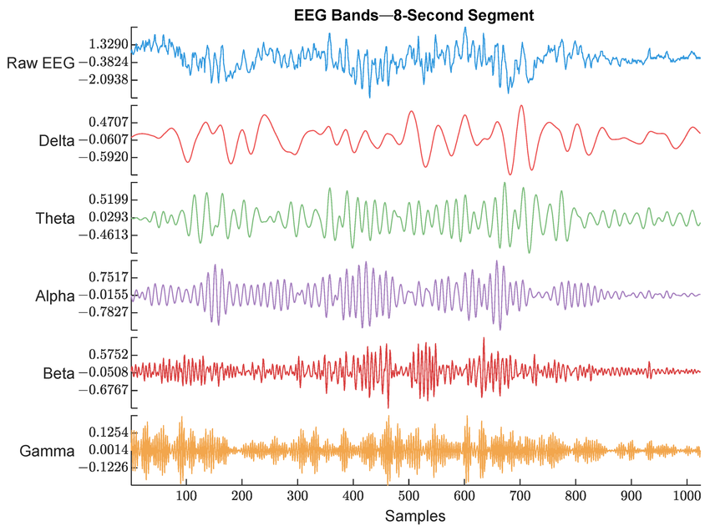
What is EEG?
What is EEG?
Records electrical activity of the brain
Captured using electrodes on the scalp
Measures signals in real-time from different brain regions
Safe, non-invasive, and cost-effective
Used in medicine, neuroscience, and now biometrics
What Does EEG Measure?
Brainwaves: rhythmic patterns of electrical activity
Frequency bands:
Delta (0.5–4 Hz) – deep sleep
Theta (4–8 Hz) – drowsiness
Alpha (8–13 Hz) – relaxed, awake
Beta (13–30 Hz) – active thinking
Gamma (30+ Hz) – high-level cognition
Abdel Deen, Omar & Shieh, Jiann-Shing. (2025). A Multimodal Deep Learning Approach to Intraoperative Nociception Monitoring: Integrating Electroencephalogram, Photoplethysmography, and Electrocardiogram. Sensors. 25. 1150. 10.3390/s25041150.
Notes:
So before diving into how EEG is used in biometric security, let me explain what EEG actually is.
EEG stands for electroencephalography. It records the brain’s electrical activity using small electrodes placed on the scalp. These sensors pick up real-time signals from different parts of the brain.
It’s a safe and non-invasive method that’s been used for decades in medicine and neuroscience—and now increasingly in biometrics.
EEG measures rhythmic patterns of electrical activity in the brain, commonly called brainwaves. These patterns fall into different frequency bands:
Delta waves, from 0.5 to 4 Hz, are associated with deep sleep.
Theta, 4 to 8 Hz, often appear during drowsiness or light sleep.
Alpha waves, 8 to 13 Hz, are seen when we’re awake but relaxed.
Beta, 13 to 30 Hz, are linked with active thinking.
And Gamma, above 30 Hz, are involved in complex cognitive processes.
For this study, we focused specifically on the alpha band. That’s because alpha waves are consistent, subject-specific, and typically appear during calm but alert states. These properties make alpha-band signals ideal for EEG-based biometric authentication."

Slide 8
Methods (EEG Data Collection)
Data Collection Overview :
Conducted at the University of Wisconsin-La Crosse BCI Lab
Equipment: g.tec EEG headset (16-channel cap)
Protocols: Eyes Open (EO)
Each session: 3 minutes total.
Participants: 25 subjects, EO , 3-minute sessions.
Two sessions per participant, spaced days to a week apart
Notes:
For this study, we collected EEG data right here at the University of Wisconsin-La Crosse, specifically in the BCI Lab.
We used a 16-channel EEG headset from g.tec, which provides good spatial coverage while being non-invasive and comfortable for the participants.
The protocol was simple and practical: participants sat quietly with their eyes open—also known as the ‘Eyes Open’ or EO protocol. This is important because open-eye EEG reflects more natural, real-world brain activity compared to eyes-closed or task-based setups.
Each recording session lasted 3 minutes, and we had 25 different participants.
To evaluate consistency over time, each person completed two separate sessions, spaced out by a few days to a week. This allowed us to explore how stable the EEG patterns were across time, which is important for real-world biometric applications.

Slide 9
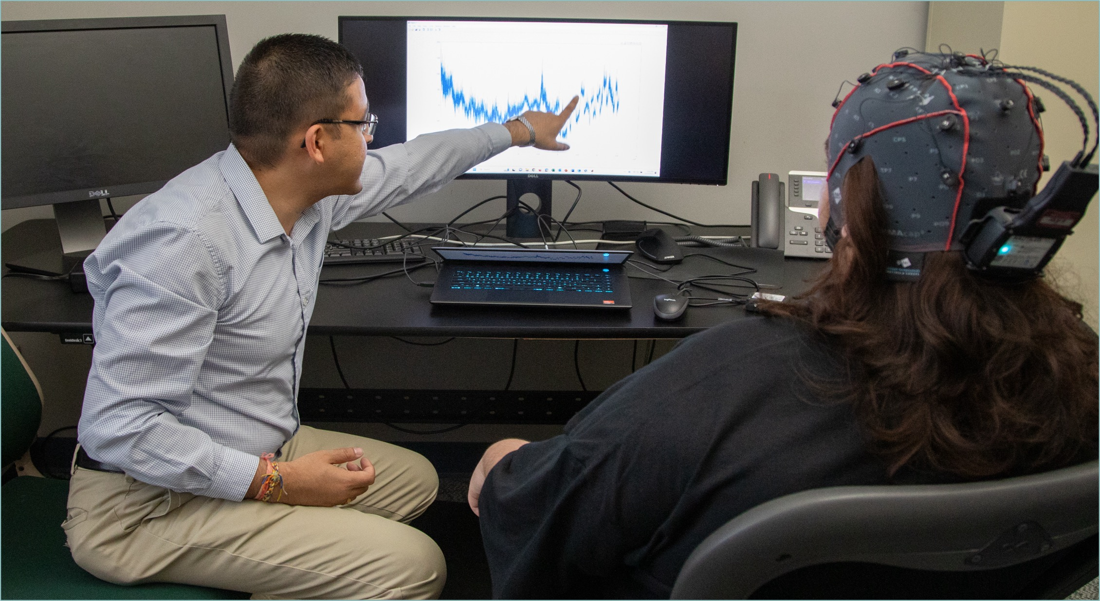
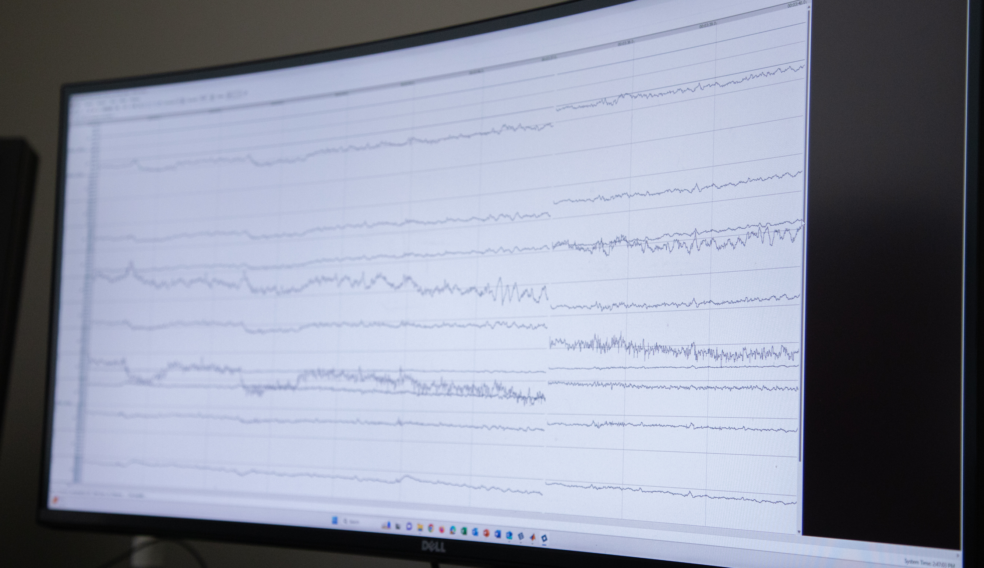
Acquiring Data

Slide 10

Stimuli For Acquiring Data

Slide 11
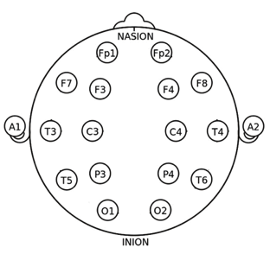
Methods (EEG Data Collection)
Electrode Placement:
Selected nodes: All nodes except for Fp1 and Fp2 .
Focused on central and occipital regions for distinct EEG patterns.
These areas are known to reflect cognitive processing and visual activity under open-eye conditions
Öztürk, Hakan & Türe, Mevlüt & Kiylioglu, Nefati & Omurlu, Imran. (2017). The comparison of different dimension reduction and classification methods in EEG signals. Meandros Medical and Dental Journal. 19. 10.4274/meandros.96168.
Notes:
In terms of electrode placement, we focused on eight specific nodes (highlighted in blue
These positions lie primarily in the central and occipital regions of the scalp.
We chose these areas intentionally because they’re highly relevant for open-eye conditions—central regions are linked to cognitive processing, while occipital regions are involved in visual activity.
By targeting these nodes, we aimed to capture strong, distinctive EEG signals that are both stable and subject-specific, which is essential for biometric authentication.

Slide 12
Methods (Data Pre-Processing)
Spectral Filtered (Alpha Band Filter): 8–12 Hz
Down-Sampling to 125 Hz
Z-Score Normalisation
Detrending
Notes:
Now that we’ve looked at what EEG is and what it measures, let’s go over how we prepared the data before feeding it into the neural network.
The first step is spectral filtering, where we apply a bandpass filter to isolate the alpha band—between 8.1 and 12.3 Hz.
This frequency band is particularly useful for biometrics because it’s stable, consistent, and tied to individual brain activity when we’re calm but alert. By isolating this range, we’re filtering out unnecessary noise and focusing on the signal components that matter most.
Then we downsample the data. The raw EEG was recorded at 250 Hz, but we reduce it to 125 Hz to make processing more efficient. Each EEG template is extracted using a 600-millisecond window, which aligns nicely with the new sampling rate and keeps the input manageable.
Next is Z-score normalisation. This step ensures that each EEG channel across all participants and sessions has a mean of 0 and a standard deviation of 1. It basically levels the playing field, so the network can learn useful patterns without being thrown off by large variations between individuals.
We also apply detrending, which removes slow drifts in the signal. These are low-frequency components that often reflect environmental interference or physical movement rather than meaningful brain activity.
Now here’s where the data becomes model-ready. We divide the EEG into multiple short segments or templates, each lasting 5 seconds. Each template contains signals from 14 EEG channels, and since we’ve downsampled to 125 Hz, that gives us 625 time points per channel—so the final shape is [14 × 625].
These templates are pulled from three different mental states—Eyes Closed, Eyes Open, and Motor Imagery—using a sliding window technique with about 50% overlap. This creates a more diverse dataset without needing extra recording time.
Each participant ends up with 40 templates in total: around 14 from Eyes Closed and 13 each from Eyes Open and Motor Imagery. If someone has fewer than 40, we randomly duplicate some segments to keep the dataset balanced.
So in the end, each 5-second EEG snippet becomes a standalone input to the CNN. This helps the model learn the person’s unique brainwave signature from just short bursts of brain activity.

Slide 13
Methods (Deep Learning Framework)
Neural networks are computer models inspired by how the brain works. They learn patterns from data by connecting simple units called “neurons.”
CNNs, or convolutional neural networks, are a type of neural network that’s especially good at processing signals over time—like EEG data.
Our CNN looks at both how brain signals change over time and how different channels relate to each other.
It takes in a 14 by 625 segment—14 EEG channels recorded over 5 seconds—and uses layers of processing to figure out which person the signal came from.
Notes:
So once the EEG data is pre-processed and reshaped into these short, structured templates, we feed it into a deep learning model to perform classification.
This model is a Neural Network, which is a type of machine learning algorithm inspired by how our brains process information. It consists of multiple layers of interconnected nodes—kind of like artificial neurons—that learn to recognise patterns by adjusting weights and connections as they process more data.
NO REINFORCEMENT
For this study, we use a specific type of neural network called a Convolutional Neural Network, or CNN. CNNs are especially good at handling grid-like data structures—like images or, in our case, EEG signals that vary across both time and space.
Our CNN is designed to learn two key aspects of the EEG data. First, it captures temporal patterns—so, how the signal changes over time. And second, it learns spatial relationships—how different EEG channels interact with each other at any given moment.
The input to the network is a 14 by 625 segment—that’s 14 channels recorded over 5 seconds, downsampled to 125 time points per second. The network then passes this through multiple convolutional layers that detect meaningful signal patterns. Finally, based on those patterns, it predicts which subject that EEG segment likely belongs to.
So essentially, the CNN is learning to recognise a person’s brain activity the same way facial recognition systems learn to identify someone’s face—except instead of pixels, we’re working with raw brainwaves.

Slide 14
Methods (Deep Learning Framework)
Core CNN Layers
Convolutional Layers: Detect patterns in EEG signals, both over time (temporal) and across electrodes (spatial).
ReLU Activation: Adds non-linearity so the network can learn more complex brainwave features.
Pooling Layers: Downsample data to reduce noise and improve generalisation.
Regularisation and Classification
Dropout Layers: Randomly deactivate neurons during training to prevent overfitting.
Fully Connected Layers: Combine features and make the final decision.
Softmax + Classification: Outputs a probability for each subject, choosing the most likely one.
Notes:
Convolutional Layers: Apply small filters to the input data to detect local patterns. In EEG, temporal filters track changes in brain signals over time, while spatial filters learn relationships across EEG channels (e.g. activity in frontal vs. occipital regions).
ReLU Activation Layers: Add non-linearity to the network. This enables the model to learn complex and abstract brainwave patterns, beyond simple straight-line relationships.
Pooling Layers (Max Pooling): Downsample the data by taking the most prominent values in local regions. This reduces computational cost and makes the network more robust to noise or small temporal shifts in the signal.
Dropout Layers: Randomly deactivate a portion of neurons during training. This prevents the model from relying too heavily on specific features and helps generalise better to new, unseen data.
Fully Connected Layers: These dense layers act like decision-making layers. They combine all learned features into a high-level representation used to determine which subject the EEG belongs to.
Softmax + Classification Layer: The final layer outputs a probability distribution over all subjects. The subject with the highest probability is selected as the prediction.

Slide 15
Our Custom-Built CNN for EEG Signals
Input → [14 × 625 × 1] EEG segment (14 channels, 5s @125Hz, z-scored)
Feature Extraction Stack:
Conv1 [5×15], BN, ReLU → [10 × 611 × 32]
Pool1 [2×2] → [5 × 305 × 32]
Conv2 [5×15], BN, ReLU → [1 × 291 × 64]
Pool2 [1×2] → [1 × 145 × 64]
Conv3 [1×15], BN, ReLU → [1 × 131 × 128]
Dropout (30%)
Pool3 [1×5] → [1 × 26 × 128]
Conv4 [1×13], BN, ReLU → [1 × 14 × 256]
Conv5 [1×14], BN, ReLU → [1 × 1 × 512]
Classifier Head:
Flatten → [512]
FC1 [256], BN, ReLU, Dropout (50%)
FC2 [128], BN, ReLU, Dropout (40%)
FC Output [25 Subjects], Softmax → Classification
Notes:
During training, the CNN uses backpropagation to adjust its weights. Errors between predicted and true identities are propagated backward through the network to update filters and improve accuracy. The model was trained using the Adam optimiser with a low initial learning rate (0.0005), early stopping, and dropout to prevent overfitting. No data augmentation was used — training relied on original session data only. An 80/20 validation split was used for performance monitoring during training.
We break the EEG input down to a [1×1×512] representation to compress both spatial and temporal features into a compact, high-level brainprint. This makes classification more efficient and helps the model focus on the most informative patterns for identifying individuals.

Slide 16
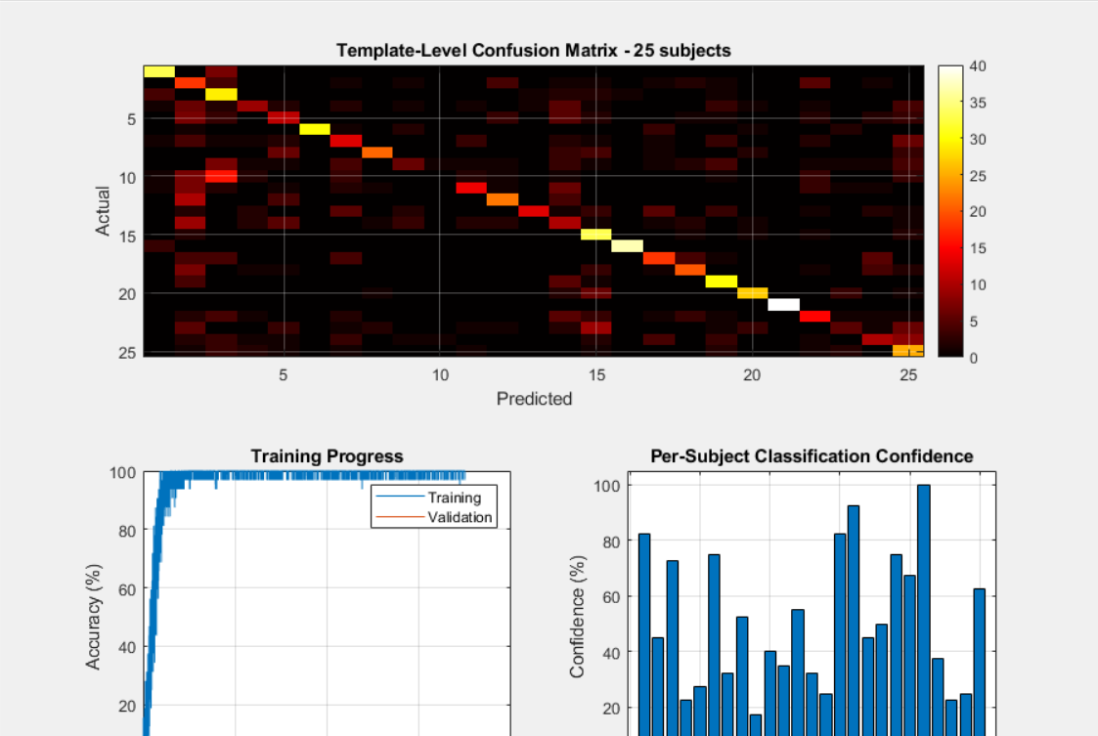
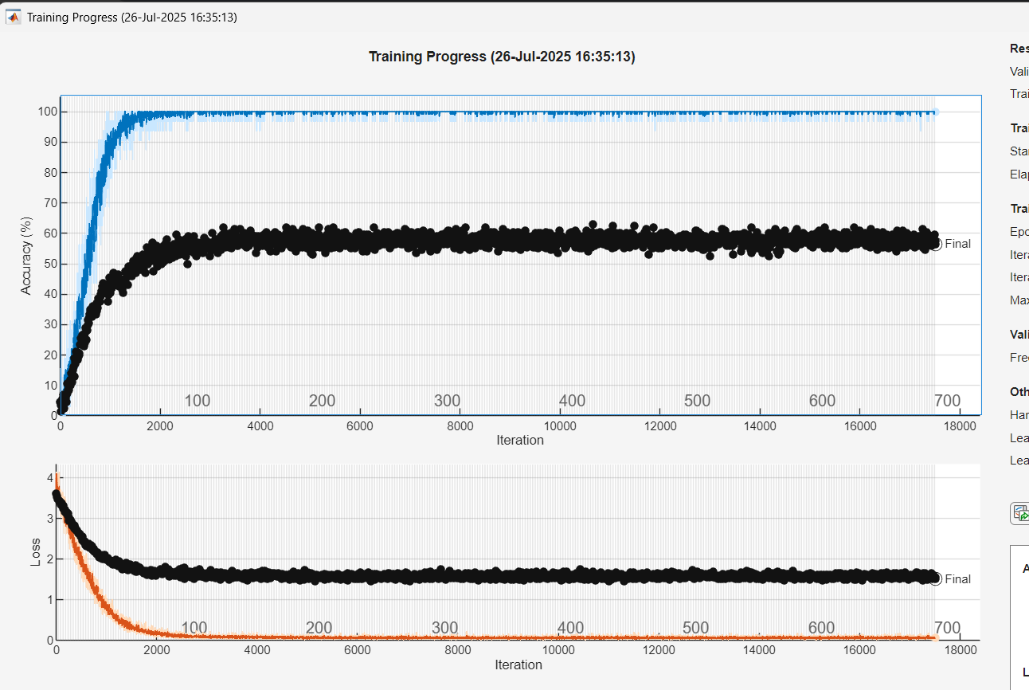
Results and Performance
Notes:
On the left, you can see a template-level confusion matrix for 25 subjects. Each row represents the true identity of a subject’s EEG template, and each column shows who the model predicted it belonged to. The brighter the diagonal, the better—it means the model is correctly identifying templates most of the time. And we do see a fairly strong diagonal here, which is promising.
On the right, we have another training plot with more iterations. It confirms the same trend: training accuracy climbs rapidly, while validation accuracy stabilises below it. The loss curve beneath it also shows a healthy drop during training, indicating effective learning.
For EEG data, that’s actually quite good—especially with open-eye conditions and short input segments. It shows that even brief, low-noise brain activity can carry enough unique features to support biometric identification.

Slide 17
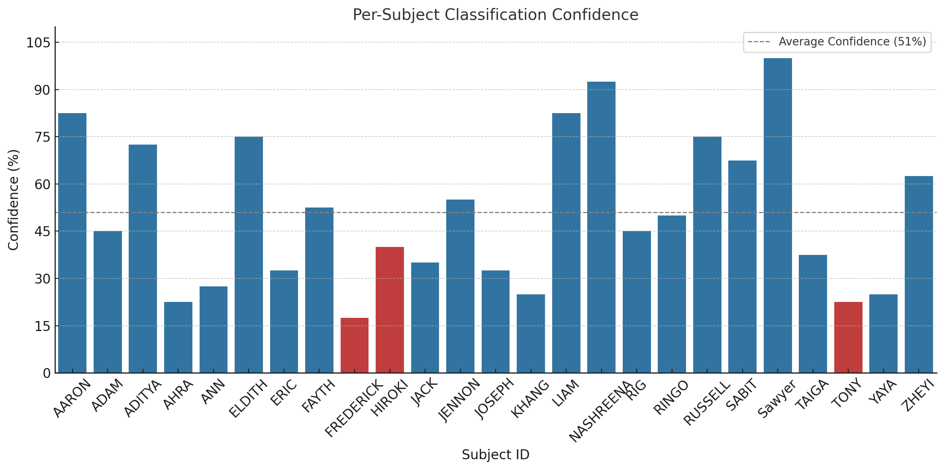
Results and Performance

Slide 18
Interpreting the Results
Key Observations
Overall Accuracy: The model correctly identified 22 out of 25 subjects (88% accuracy) — strong performance for a 25-way classification problem using only 5-second EEG clips.
High Confidence Subjects: Some subjects (e.g. Sawyer – 100%, Nashreena – 92.5%, Liam – 82.5%) were classified with very high confidence, suggesting consistent EEG patterns across their templates.
Misclassifications:
Frederick, Hiroki, and Tony were incorrectly identified.
These subjects had lower confidence scores (≤ 40%) — indicating possible overlap in EEG features with others or high intra-subject variability.
Confidence Spread
Confidence ranged from 22.5% to 100% across subjects.
Average: 51% – above chance level (4%) in a 25-class problem, showing the model learned meaningful distinctions.
Lower confidence does not always mean wrong but does signal uncertainty.
What This Tells Us
EEG segments do carry discriminative features for identity.
Some users may be inherently easier to identify due to stable EEG patterns.
More data per subject could help reduce uncertainty and boost confidence.
Notes:
Starting with overall accuracy: The model correctly identified 22 out of 25 subjects, which is an 88% accuracy. That’s quite strong, especially considering we’re working with short, 5-second EEG clips and a 25-class classification task.
We also saw some high-confidence subjects—like Sawyer, Nashreena, and Liam—who were consistently classified with confidence levels above 80 or even 90 percent. This suggests their EEG patterns were particularly stable and distinct across trials.
On the flip side, we had a few misclassifications—specifically Frederick, Hiroki, and Tony. These subjects also showed lower confidence scores, often below 40 percent. That likely points to either overlapping EEG features with others or high variability within their own recordings.
Looking at the confidence spread, it ranged from about 22% to 100%. The average was around 51%, which is well above the random baseline of 4% in a 25-subject classification task. So even lower-confidence predictions weren’t just noise—they still carried useful signal.
It’s also important to remember: lower confidence doesn’t necessarily mean the prediction was wrong—it simply reflects how certain the model was. And that uncertainty can be tied to signal noise, user state, or the number of examples available.
So, what can we take away from this?
First, EEG data does contain unique patterns that are consistent enough to distinguish between individuals.
Second, some users may be inherently easier to identify due to more stable brainwave patterns.
And finally, having more data per user would likely improve both model performance and confidence, especially for borderline cases.

Slide 19
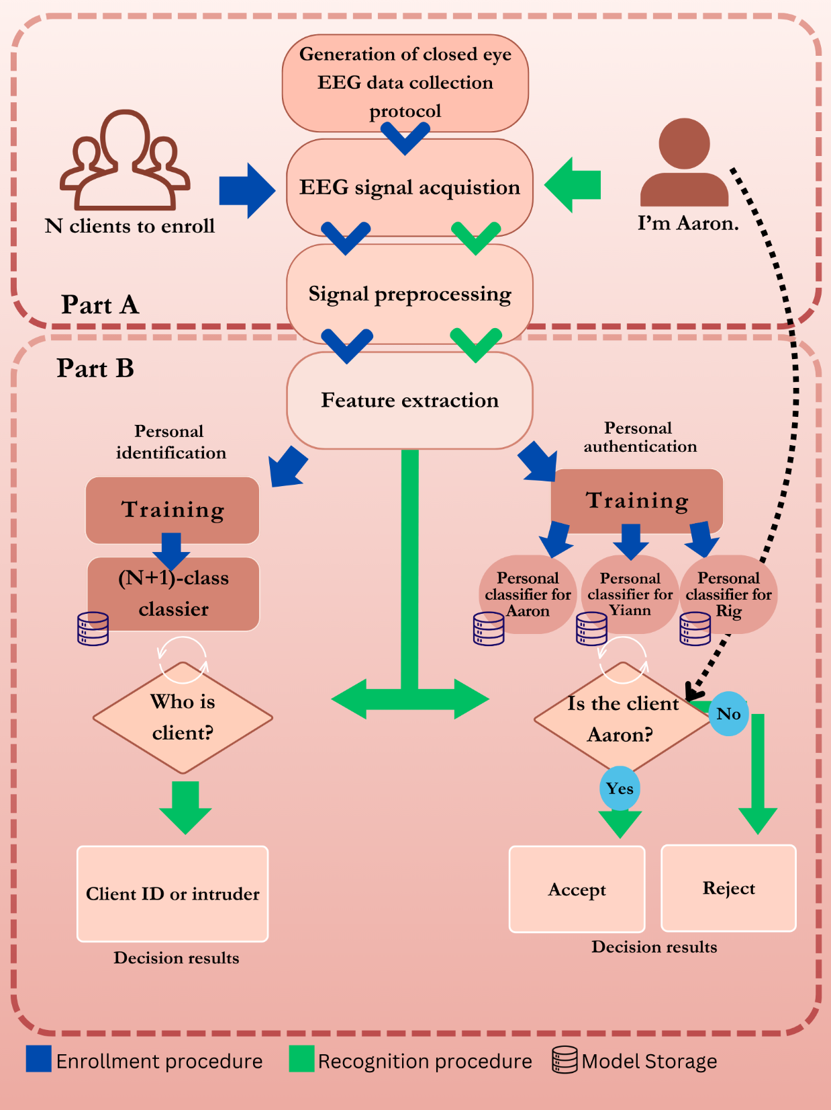
Brief Overview of Research Project

Slide 20

Limitations and Future Plans
Limitations
Small dataset: Only 25 subjects.
Risk of overfitting due to limited variation.
Some subjects had low confidence (e.g. Ahra, Tony).
Closed-set only: No impostor (unknown subject) evaluation.
Future Work
Collect more EEG data across multiple days.
Add impostor rejection for real-world verification.
Explore subject-specific fine-tuning.
Optimise model for lightweight, real-time use.
Test robustness against spoofing or mimicry attacks.
Notes:
Let’s wrap up with some of the limitations of our current work, and where it can go from here.
First, our dataset was relatively small — we only had 25 subjects. While this was enough to train a basic model, it limits the diversity of brain states captured and increases the risk of overfitting.
We also observed that some subjects had consistently low confidence, like Ahra and Tony, which may suggest variability in their brain activity or noise in the recording sessions.
Another key point is that this was a closed-set classification task — meaning the model only tried to distinguish between known individuals. We didn’t yet evaluate how it would perform with unknown or impostor subjects, which is critical for real-world authentication systems.
Now looking ahead, there are a few clear future directions.
First, we want to collect more EEG data across multiple days. This would help capture natural variability in brain signals and improve generalisability.
We also plan to introduce impostor rejection, so the system can recognise when someone outside the enrolled set is trying to log in.
In addition, we’re exploring subject-specific fine-tuning, which might help the model adapt to individual differences more effectively.
Another important step is to optimise the model for lightweight, real-time use, especially if we want to eventually deploy this on wearable devices or in edge environments.
And finally, we want to test the system’s robustness against spoofing or mimicry attacks — for example, seeing if someone can trick the system by mimicking a target user’s mental state.

Slide 21
Conclusion
Designed a custom CNN for biometric authentication using 5-second alpha-band EEG data.
Achieved high subject-level accuracy of 88.0% through majority voting across individual template predictions.
Model was evaluated cross-session, simulating real-world authentication across different recording days.
Demonstrated the feasibility of non-invasive EEG-based identification using deep learning, even with limited training data.
Results support the use of temporal-spatial EEG features as reliable biometric traits.
Notes:
Designed a custom CNN for biometric authentication using 5-second alpha-band EEG data.
Achieved high subject-level accuracy of 88.0% through majority voting across individual template predictions.
Model was evaluated cross-session, simulating real-world authentication across different recording days.
Demonstrated the feasibility of non-invasive EEG-based identification using deep learning, even with limited training data.
Results support the use of temporal-spatial EEG features as reliable biometric traits.

Slide 22

Any Questions?
Phone Number: +1 901 336 7660
Email: jeyaraj9413@uwlax.edu or aaronaj60@gmail.com
Notes:
That brings me to the end of my presentation.
Thank you so much for listening.
If you have any questions, Ill try my best to answer now
And if you'd like to connect later or learn more, feel free to reach out using the contact details on the screen — or simply scan the QR code.

Slide 23
Acknowledgements
Deans Distinguished Fellowship Committee
University of Wisconsin La Crosse Computer Science Department
Dr. Rig Das
Undergraduate Students: Ahra Cho, Fayth Norzin, Hemachandra Konduru, Tham Yi-Ann
Notes:
Before I wrap up, I’d like to take a moment to acknowledge the people who made this research possible.
First, thank you to the Dean’s Distinguished Fellowship Committee for funding and supporting this project.
I’d also like to thank the University of Wisconsin–La Crosse Computer Science Department for providing the resources and guidance I needed throughout this journey.
A special thanks to Dr. Rig Das for their mentorship, encouragement, and insightful feedback.
And lastly, I want to recognise my fellow undergraduate collaborators: Ahra Cho, Fayth Norzin, Hemachandra Konduru, and Tham Yi-Ann — thank you all for your help and support during this work.

Slide 24

References
[1] M. Näpflin, M. Wildi, and J. Sarnthein, “Test–retest reliability of resting EEG spectra validates a statistical signature of persons,” Clinical Neurophysiology, vol. 118, no. 11, pp. 2519–2524, Nov. 2007, doi: https://doi.org/10.1016/j.clinph.2007.07.022.
[2] M. Kostílek and J. Št'astný, “EEG biometric identification: Repeatability and influence of movement related EEG,” in 2012 International Conference on Applied Electronics, pp. 147–150.
[3] D. L. Rocca, P. Campisi, and G. Scarano, “EEG biometrics for individual recognition in resting state with closed eyes,” in 2012 BIOSIGProceedings of the International Conference of Biometrics Special Interest Group (BIOSIG), pp. 1–12.
[4] M. Benomar, S. Cao, M. Vishwanath, K. Vo, and H. Cao, “Investigation of EEG-Based Biometric Identification Using State-of-the-art Neural Architectures on a RealTime Raspberry PiBased System,” Sensors, vol. 22, p. 9547, Dec. 2022, doi: https://doi.org/10.3390/s22239547.
[5] L. Ma, J. W. Minett, T. Blu, and W. S. Y. Wang, “Resting State EEG-based biometrics for individual identification using convolutional neural networks,” in 2015 37th Annual International Conference of the IEEE Engineering in Medicine and Biology Society (EMBC), pp. 2848–2851. doi: https://doi.org/10.1109/EMBC.2015.7318985.

Slide 25
References
[6] C. J. X, M. Z. J, Y. W. X, and H. Y. F, “EEG-based biometric identification with convolutional neural network,” Multimedia Tools and Applications, vol. 79, no. 15, pp. 10655–10675, 2020, doi: https://doi.org/10.1007/s1104201972584.
[7] I. Kralikova, B. Babusiak, and M. Smondrk, “EEG-Based Person Identification during Escalating Cognitive Load,” Sensors (Basel, Switzerland), vol. 22, Sep. 2022, doi: https://doi.org/10.3390/s22197154.
[8] C. Q. Lai, H. Ibrahim, S. A. Suandi, and M. Z. Abdullah, “Convolutional Neural Network for Closed-Set Identification from Resting State Electroencephalography,” Mathematics, vol. 10, no. 19, p. 3442, Sep. 2022, doi: https://doi.org/10.3390/math10193442.
[9] D. L. Rocca et al., “Human brain distinctiveness based on EEG spectral coherence connectivity,” IEEE Transactions on Biomedical Engineering, vol. 61, pp. 2406–2412, 2014, Available: https://api.semanticscholar.org/CorpusID:18320

